Slide 1


Audiometric Testing Practicum 2
Tri-Service Hearing Technician
4.2 Certification Course

Slide 2
Audiometric Testing Practicum 2
Learning Objectives
4.3.1 Perform a successful functional check and a successful calibration, troubleshoot appropriately
4.3.2 Input patient data correctly while testing patient
4.3.3 Select correct test type/reason
4.3.4 Transfer/Retrieve audiograms
4.3.5 Counsel/Educate patients properly
4.3.6 Know when to perform otoscopic examination and fit HPDs
4.3.7 Retest or process referrals correctly
Tri-Service Hearing Technician 4.2.0.0 Certification Course

Slide 3
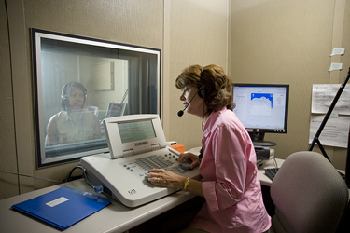
Audiometric Testing Practicum 2
Pretest Processes
Perform a successful functional check
Perform a successful calibration
When done, bring up the DD Form 2217 for the week
Tri-Service Hearing Technician 4.2.0.0 Certification Course
Notes:
Image: Defense Imagery Digest www.defenseimagery.mil
Check 2217s

Slide 4
Audiometric Testing Practicum 2
Patient #4, Testing Blake Owens
Using the BAS to simulate a patient
  Pre-instructions to patient - Start test
Input Blake Owens as a patient [SSN = 990990027 - Run Test Window]
  Ensure all demographic data is correct
  Select the correct test type/reason based on audiometric history, demographic data form
Transfer/Retrieve data between the Run Test/CCA-200 windows
  Pay attention to any pop-up windows that occur
Print audiogram, prepare counseling thoughts, have patient return for follow-up testing or refer appropriately
15 minutes to complete
Tri-Service Hearing Technician 4.2.0.0 Certification Course
Notes:
Headphones on the BAS, response switch removed to activate the BAS; Any questions?

Slide 5
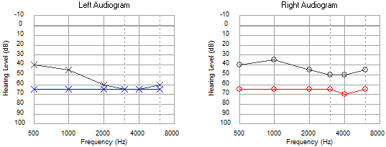
Audiometric Testing Practicum 2
Patient #4, Testing Blake Owens
[SSN = 990990027]
Tri-Service Hearing Technician 4.2.0.0 Certification Course
Notes:
Note the manual tested thresholds in the CCA-200 software does not transfer over to the Run Test window.

Slide 6
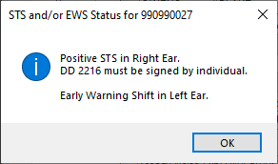
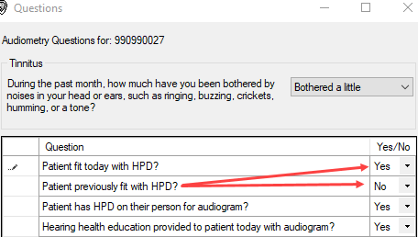
Audiometric Testing Practicum 2
Patient #4, Testing Blake Owens
Patient stated they did not remember getting fitted for HPDs
Technician should do an otoscopic exam and fit for HPDs
Tri-Service Hearing Technician 4.2.0.0 Certification Course
Notes:
DD Form 2216 remarks are present for the latest test on the form; limited area for remarks;

Slide 7
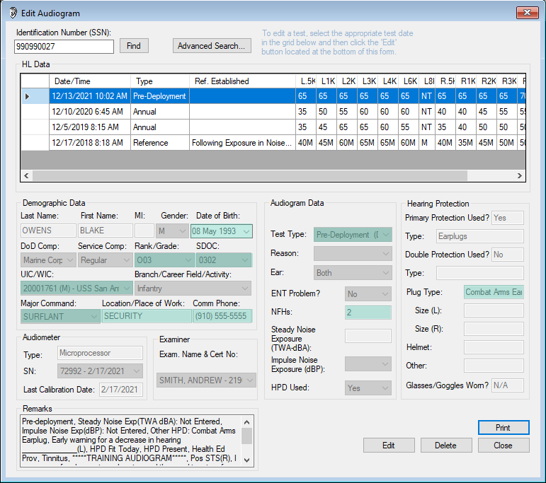
Notes:
Have students go to the Edit Audiogram Window to review.
DD Form 2216 remarks are present for the latest test on the form; limited area for remarks;
Changes are highlighted on slide: DOB/MOS changed? UIC properly selected? Location entered? Phone number changed? Test selection? HPDs added/fitted?

Slide 8
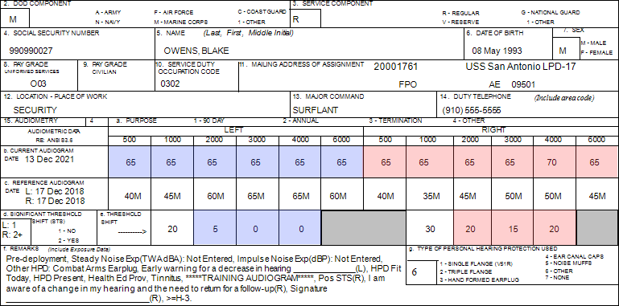
Confirm demographic fields 2 thru 14; Is there a change in hearing? Are thresholds within the range of normal? Where does the patient need to go?
Notes:
Above 2216 mimics completed testing EWS on left ear, STS on right ear. Have student do an individual counseling.
Need to return for follow-up testing, 14 hours noise free, when can they return… Sign 2216
Moderate Severe hearing loss both ears

Slide 9
Audiometric Testing Practicum 2
Patient #5, Testing Jamal Deloach
Using the BAS to simulate a patient
  Pre-instructions to patient - Start test
Input Jamal Deloach as a patient [SSN = 990990028 - Run Test Window]
  Ensure all demographic data is correct
  Select the correct test type/reason based on audiometric history, demographic data form
Transfer/Retrieve data from the run test window to the CCA-200
  Pay attention to any pop-up windows that occur
Print audiogram, prepare counseling thoughts, have patient return for follow-up testing or refer appropriately
20 minutes to complete
Tri-Service Hearing Technician 4.2.0.0 Certification Course
Notes:
Headphones on the BAS, response switch removed to activate the BAS; Any questions?

Slide 10
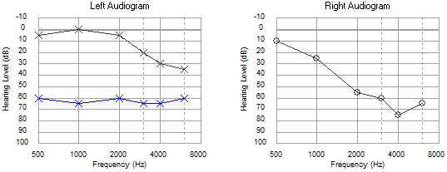
Audiometric Testing Practicum 2
Patient #5, Testing Jamal Deloach
[SSN = 990990028]
Only the ear that had an STS requires Follow-up testing
Tri-Service Hearing Technician 4.2.0.0 Certification Course

Slide 11
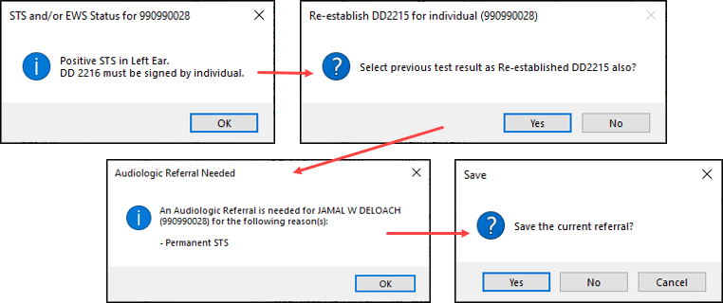
Audiometric Testing Practicum 2
Patient #5, Testing Jamal Deloach (Retrieval)
[SSN = 990990028]
Tri-Service Hearing Technician 4.2.0.0 Certification Course

Slide 12
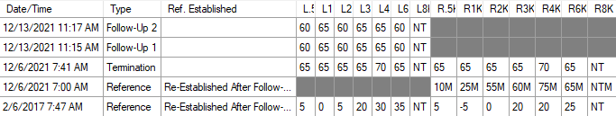
Audiometric Testing Practicum 2
Patient #5, Testing Jamal Deloach (Audiometry Summary)
[SSN = 990990028]
Conduct Follow-up 1 and Follow-up 2
Do not re-establish the baseline
Tri-Service Hearing Technician 4.2.0.0 Certification Course

Slide 13
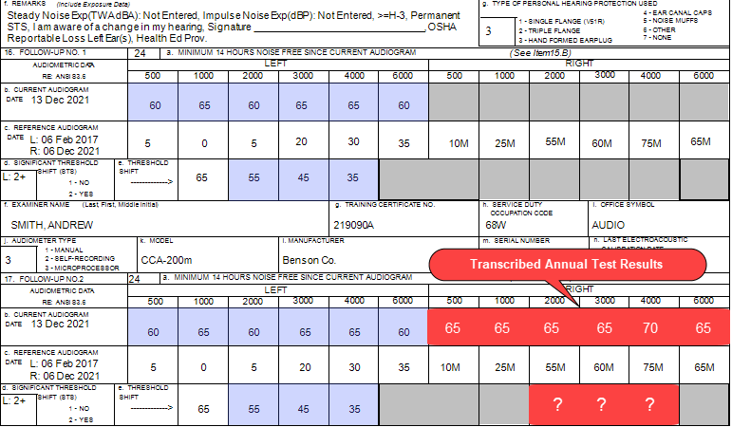
Notes:
Confirm demographic fields 2 thru 14; Is there a change in hearing? Are thresholds within the range of normal? Where does the patient need to go? Additional Comments?
Counseling thoughts: STS Left ear, Moderate Severe hearing loss both ears, when can they return to see the audiologist, 14 hours noise free? Sign 2216
Did any of the students have an STS in both ears?

Slide 14
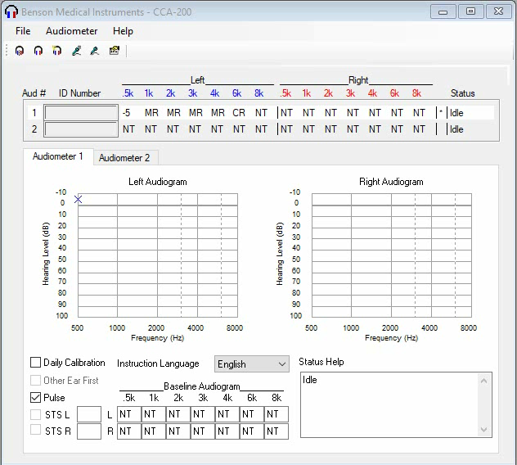
Notes:
Video
Remind students, set NT (not tested) for the correct ear/frequencies that need to be manually tested; once the patient responds do not adjust decibels level, vary stimuli presentations, once the patient responds twice in an ascending mode thresholds will lock in, press OK, “M” identifier will be present in the CCA-200 window.

Slide 15
Audiometric Testing Practicum 2
Patient #6, Testing Each Other
Insert hand switch into BAS
Ensure wiring is untangled
Class broken down into groups of two
Receive audiograms and demographic form (all students are in the HCP)
  Review forms (all students review the form of the person you are going to test - ask any questions prior to classroom testing)
  Give pre-testing instructions to each other prior to classroom testing
  Ensure the patient cannot see the DOEHRS-HC work station while testing
  Patient has headphones on, response switch in hand
Without much talking switch examiner/patient roles once testing is complete. Any questions?
Tri-Service Hearing Technician 4.2.0.0 Certification Course
Notes:
Prior to students testing each other, create testing scenarios similar to what will be found in the field: give two students 1 ear plug to create a asymmetry/masking; give one student 2 earplugs to create STS on both ears – have the examiner do a termination test on this patient; change one students 2215 to create a negative shift on one ear; ask another student to try to put the headphones on backwards, if they had one ear worse that the other on the reference audiogram it would be better
Break class down in groups of 2, try to separate those that are from the same units so a UIC will need to be added into the local database
If there is an odd number of students, ensure those that previous tested as examiners (recertification) are patients. There is an additional demographic sheet in the training book that an odd student can use for testing one of the classroom facilitators.

Slide 16
Audiometric Testing Practicum 2
Patient #6, Testing Each Other
Start automated test
Input demographic data into the run test window; select test type
Transfer data from the run test window to the CCA-200
  Manually test the patients right ear, 3000 Hz, 4000 Hz and 6000 Hz
Retrieve audiogram from the CAA-200 window to the Run Test window (pay attention to any pop-up windows that occur)
Print audiogram - counsel, educate appropriately, otoscopic exam, fit or refit HPDs
Do not clear the Run Test window or the CCA-200 window
Switch places, examiner becomes the patient/patient becomes the examiner
Tri-Service Hearing Technician 4.2.0.0 Certification Course
Notes:
Without much talking switch examiner/patient roles once testing is complete. Any questions?
Headphones on patient, response switch in hand, back toward examiner
Leave this slide up while the students test each other, monitor time, once the initial student is done testing, have them switch roles and the examiner becomes the patient.
Check students run test/CCA-200 for correct data input/testing once switched over/completed

Slide 17
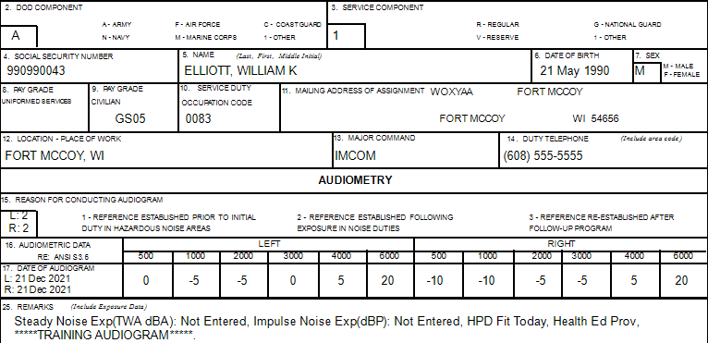
Reference Audiogram
Notes:
Have a student (if possible one that conducted a reference audiogram on their patients audiogram) come up and conduct counseling/training on the above audiogram.

Slide 18
Audiometric Testing Practicum 2
Reference Audiogram
Elements and rationale of the HCP
Effects of noise on hearing (occupational and non-occupational)
Purpose, styles and proper use of various HPDs
  Otoscopic exam and fit HPDs
Command and employee responsibilities for HC
Impact hearing loss may have on career, safety and mission
Purpose of hearing tests and procedures
  Review/Explain Audiogram
Service-specific requirements
Tri-Service Hearing Technician 4.2.0.0 Certification Course

Slide 19
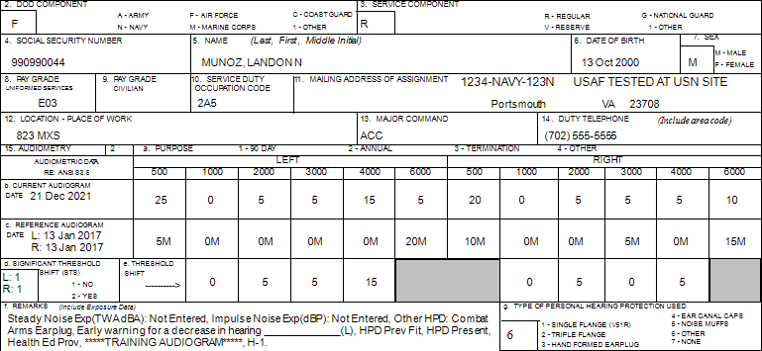
Early Warning Shift Audiogram
Notes:
Have a student (if possible one that conducted a test that had an EWS on their patients audiogram) come up and conduct counseling/training on the above audiogram.

Slide 20
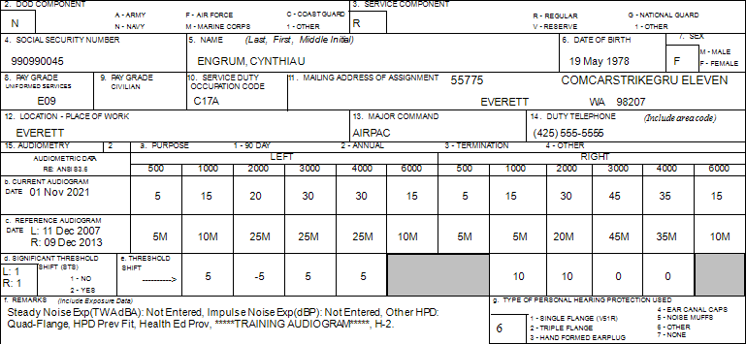
No Change in Hearing Audiogram
Notes:
Have a student (one that conducted a test that did not have a change in hearing on their patients audiogram) come up and conduct counseling/training on the above audiogram.
If patient was USA/USAF what else may need to be done? Profile change

Slide 21
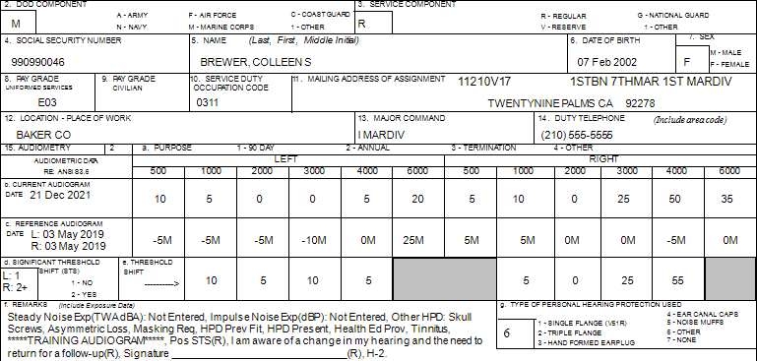
Positive STS/Asymmetry/Masking Audiogram
Notes:
Have a student (if possible one that conducted a test that had a Positive STS/Asymmetry/Masking on their patients audiogram) come up and conduct counseling/training on the above audiogram.

Slide 22
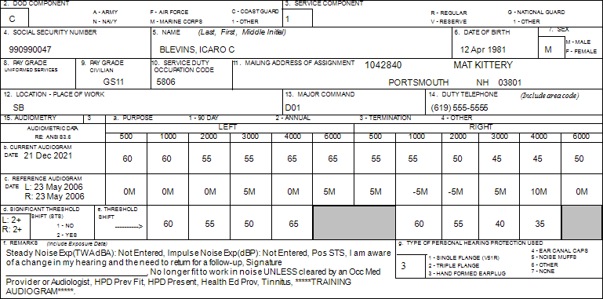
Pseudohypacusis Hearing Loss Audiogram
Notes:
Have a student (if possible one that conducted a test that had a non-organic hearing loss on their patients audiogram) come up and conduct counseling/training on the above audiogram.

Slide 23
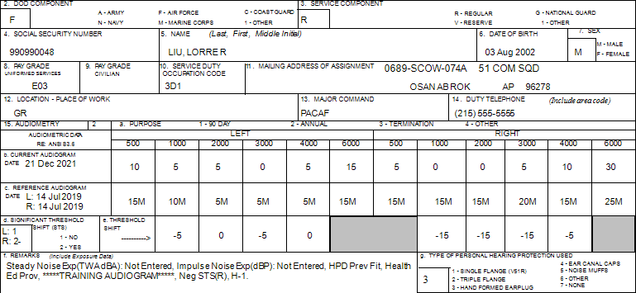
Negative STS Audiogram
Tri-Service Hearing Technician 4.2.0.0 Certification Course
Notes:
Have a student (if possible one that conducted a test that had a non-organic hearing loss on their patients audiogram) come up and conduct counseling/training on the above audiogram.

Slide 24
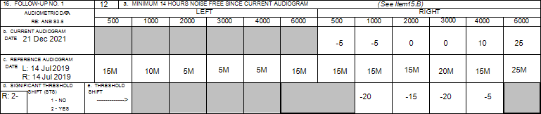
Negative STS Follow-up 1 Audiogram
Tri-Service Hearing Technician 4.2.0.0 Certification Course
Notes:
Have a student (if possible one that conducted a test that had a non-organic hearing loss on their patients audiogram) come up and conduct counseling/training on the above audiogram.

Slide 25
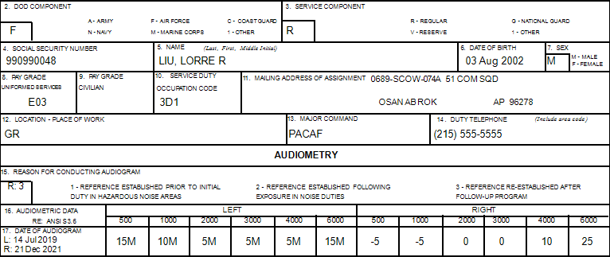
Negative STS Re-establishment Audiogram
Tri-Service Hearing Technician 4.2.0.0 Certification Course
Notes:
Have a student (if possible one that conducted a test that had a non-organic hearing loss on their patients audiogram) come up and conduct counseling/training on the above audiogram.

Slide 26
Audiometric Testing Practicum 2
Summary
Successful pre-checks/tests
Patient demographic input
Audiograms types/reasons
Transfer/Retrieve audiograms
Counsel/Educate patients properly
Know when to perform otoscopic examination and fit HPDs
Retest or process referrals correctly
Tri-Service Hearing Technician 4.2.0.0 Certification Course

Slide 27
Audiometric Testing Practicum 2
? Questions ?
Tri-Service Hearing Technician
4.2 Certification Course

